Slide 1
Classification training – Additional labelling
DELIVERING
GROWTH IN SPECIALITY CHEMICALS
Megan Wheatley-Darrand
June 2024

Slide 2
Introduction
Agenda
Background
EUH208
Introduction
Obligatory supplemental labelling information
EUH phrases
Non-obligatory supplemental labelling information
Questions
EUH208
Concentration limits
Specific Concentration Limits (SCLs)
Examples

Slide 3
Background

Slide 4
Classification training – Additional labelling
Introduction
CLP Article 25 defines the concept of ‘supplemental information which is intended to incorporate additional labelling information.
This additional labelling information can be divided into two categories; namely obligatory and non-obligatory information.
Notes:
CLP Article 25 defines the concept of ‘supplemental information which is intended to incorporate additional labelling information.
This additional labelling information can be divided into two categories; namely obligatory and non-obligatory information. Please note that according to CLP Article 25, supplemental labelling information might be obligatory for a mixture, even if not classified as hazardous.
Both obligatory and non-obligatory supplementary information have to appear in the same languages as the other CLP label elements.

Slide 5
Classification training – Additional labelling
Obligatory supplemental labelling information
Obligatory supplemental labelling information includes:
Supplemental hazard statements relating to particular physical and health properties. These are known as ‘EUH’ statements.
Supplemental statements for certain mixtures. These are also assigned EUH codes as well to align their presentation with the above supplemental hazard statements
The supplemental statement EUH401 for hazardous substances and mixtures within the scope of Directive 91/414/EEC.
Label elements result from other EU acts
Specific response information as referred to within brackets of the P statements.
For mixtures containing components of unknown acute toxicity at 1% or higher, the statement ‘x percent of the mixture consists of component(s) of unknown acute toxicity’.
For mixtures for which no useable information on the acute and / or chronic aquatic hazard is available for one or more components, the statement ‘contains x percent of components with unknown hazards to the aquatic environment’.
A UFI for mixtures relevant to Annex VIII of CLP under CLP Article 45.
Notes:
Obligatory supplemental labelling information includes:
Supplemental hazard statements relating to particular physical and health properties. These are known as ‘EUH’ statements. For example, EUH014 Reacts violently with water. For some substances with harmonised classifications, the supplemental hazard statements are included in Part 3 of Annex VI to CLP.
Supplemental statements for certain mixtures. These are also assigned EUH codes as well to align their presentation with the above supplemental hazard statements, such as EUH204 Contains isocyanates. May produce an allergic reaction.
The supplemental statement EUH401 ‘to avoid risks to human health and the environment, comply with the instructions for use’ for hazardous substances and mixtures within the scope of Directive 91/414/EEC.
Label elements result from other EU acts such as
The authorisation number requested by the REACH Regulation
The authorisations number of a biocidal product according to the Biocidal products regulation (BPR)
the content of volatile organic compounds (VOCs) in accordance with Directive 2004/42/EC
Specific response information as referred to within brackets of the P statements.
For mixtures containing components of unknown acute toxicity at 1% or higher, the statement ‘x percent of the mixture consists of component(s) of unknown acute toxicity’.
For mixtures for which no useable information on the short-term and / or long-term aquatic hazard is available for one or more components, the statement ‘contains x percent of components with unknown hazards to the aquatic environment’.
A Unique Formula Identifier (UFI) for mixtures relevant to Annex VIII of CLP under CLP Article 45.

Slide 6
Classification training – Additional labelling
EUH Phrases
Supplemental hazard statements relating to certain physical properties
EUH014 – Reacts violently with water
EUH018 – In use, may form flammable/explosive vapour-air mixture
Supplemental hazard statements relating to health properties
EUH029 – Contact with water liberates toxic gas
EUH031 – Contact with acid liberates toxic gas
Supplemental statements for certain mixtures
Mixtures containing lead – EUH201
EUH019 – May form explosive peroxides
EUH044 – Risk of explosion if heated under confinement
EUH032 – Contact with acids liberates very toxic gas
EUH066 – Repeated exposure may cause skin dryness or cracking
EUH070 – Toxic by eye contact
EUH071 – Corrosive to the respiratory tract
Mixtures containing isocyanates – EUH204
Cement/Cement mixtures – EUH208
Mixtures containing cyanoacrylates – EUH202
For packaging < 125mg – EUH201A
Mixtures containing epoxy constituents with Mn <= 700 – EUH205
Mixtures sold to the public containing active chlorine – EUH206
Mixtures containing cadmium (alloys) and intended for brazing or soldering – EUH207
Mixtures not sensitising but contains at least one sensitising substance – EUH208
Liquid mixtures containing halogenated hydrocarbons – EUH209 or EUH209A
Mixtures not intended for the general public – EUH210
Notes:
Here are the EUH phrases which apply under the categories listed. For the supplemental statements for certain mixtures, I have not included the text of the EUH phrases but these are readily available. EUH208 is a particular sensitive label for Synthomer.

Slide 7
Classification training – Additional labelling
Non-obligatory supplemental labelling information
In some cases, suppliers may need to include certain elements on the label that are not obligatory but are necessary for the handling and use of the product.
Such information must not be confusing or contradict the obligatory label elements.
Notes:
In some cases, suppliers may need to include certain elements on the label that are not obligatory but are necessary for the handling and use of the product such as ‘Read label before use’ or ‘Do not get in eyes’ for eye irritant mixtures.
Such information must not be confusing or contradict the obligatory label elements. Additional labelling elements from UN GHS but not implemented in CLP may be included in the section for non-obligatory supplementary information but again must not confuse the user.

Slide 8
EUH208

Slide 9
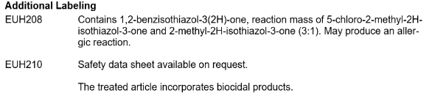
Classification training – Additional labelling
EUH208
The label on the packaging of the mixtures not classified as sensitising, but containing at least one sensitising substance classified as sensitising and present in a concentration equal or greater than that specific in Table 3.4.6 of Annex 1 shall bear the statement:
EUH208 – ‘Contains (name of sensitising substance). May produce an allergic reaction’.
Mixtures classified as sensitising containing other substance(s) classified as sensitising (in addition to the one that leads to the classification of the mixture) and present in a concentration equal to or greater than that specified in Table 3.4.6 of Annex 1 shall bear the name(s) of that/those substance(s) on the label.
Taken from SDS_IE of Emultex FR 797:
Notes:
The label on the packaging of the mixtures not classified as sensitising, but containing at least one sensitising substance classified as sensitising and present in a concentration equal or greater than that specific in Table 3.4.6 of Annex 1 (which is on the next slide) shall bear the statement:
EUH208 – ‘Contains (name of sensitising substance). May produce an allergic reaction’.
Mixtures classified as sensitising containing other substance(s) classified as sensitising (in addition to the one that leads to the classification of the mixture) and present in a concentration equal to or greater than that specified in Table 3.4.6 of Annex 1 shall bear the name(s) of that/those substance(s) on the label.
I have included an example from an EU SDS of Emultex FR 797 with the relevant additional labelling.

Slide 10
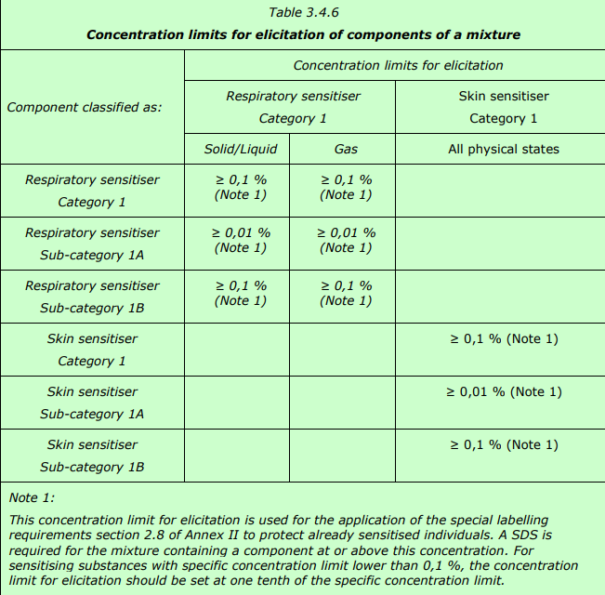
Classification training – Additional labelling
Table 3.4.6 – Concentration limits for elicitation of components in a mixture
Notes:
A mixture would classify as a Skin Sensitiser 1A at 0.1% or Skin Sensitiser 1 or 1B at 1%. Therefore, if a component classified as a skin sensitiser 1A was present in a mixture at 0.01% or higher, it would result in the labelling of EUH208 but not the overall classification as a Skin Sensitiser. Similarly, if a component was classified as a Skin Sensitiser category 1 or 1B and was present in a mixture at 0.1% or higher, it would result in the labelling of EUH208, but not the overall classification of the mixture as a sensitiser.
The exception to this rule would be if a component had a Specific Concentration Limit (SCL), the labelling of EUH208 would occur at 1/10th of the SCL.
Skin Sensitisation is not additive and each component classified as a Skin Sensitiser should be considered individually.

Slide 11
Classification training – Additional labelling
Specific Concentration Limits (SCLs)
A concentration limit is the minimum concentration of an individual substance that triggers the classification of a mixture or the sum of concentrations of relevant substances where the effect of several substances is additive.
Concentration limits may be general for a hazard class, differentiation or category (generic concentration limit GCL) or they may be specific for a particular substance (specific concentration limit, SCL). An SCL may be assigned to a substance, based on its potency, to allow the fine tuning of its contribution to the classification of a mixture. The SCL concept mainly applies to health hazards and takes precedence over GCLs.

Slide 12
Classification training – Additional labelling
Classification Examples for Skin Sensitisation
Example 1
Substance X is classified as a Skin Sensitiser Category 1, and is present in Product Y at a concentration of 1.5%.
What classification would Product Y have and does it need any special labelling?
Example 2
Substance Z is classified as a Skin Sensitiser Category 1A, and has a Specific Concentration limit of 0.001%. At what prevalence would a product containing substance Z be classified for skin sensitisation, and what prevalence would lead to an EUH208 phrase?
Example 3
Product A contains two skin sensitising substances (Category 1B). Substance B is present at 1%, and Substance C is present at 0.5%. How should the product be labelled?
Example 4
Product D contains substance E at 0.09%. Substance E is classified as Skin Sensitiser 1. How should the product be labelled?
Notes:
Example 1 - The product would be classified as a Skin Sensitiser Category 1, and no special labelling is required as the product is already classified based on this component.
Example 2 – The product would classify as Skin Sensitiser Category 1A at 0.001%, and EUH208 at 1/10th the SCL – so 0.0001%.
Example 3 – The product would be classified as a skin sensitiser Category 1B due to Substance B, and would be labelled with EUH208 as well based on Substance C.
Example 4 – No classification or additional labelling required.

Slide 13
Questions

Slide 14

Classification training – Additional labelling
Questions

Slide 15
Activity

Slide 16
Classification training – Additional labelling
Classification Examples for Skin Sensitisation
Go to Additional Special Labelling - GB.xlsx
Determine the special labelling for GB on ‘Load File’ tab. HINT: Check composition in S/4.
Compare determination with ‘All – S4’ tab and make sure previous assessments for EU and TR are accurate
Add any missing data for TR and EU as appropriate
Common Sensitisers;
CMIT/MIT – 55965-84-9
BIT – 2634-33-5
Maleic Anhydride – 108-31-6
MIT – 2682-20-4
Formaldehyde – 50-00-0

